Slide 1
Ivosidenib, a mIDH1 inhibitor in cholangiocarcinoma
Ivosidenib (Tibsovo®) is indicated for the treatment of adult patients with locally advanced or metastatic cholangiocarcinoma with an isocitrate dehydrogenase-1 (IDH1) R132 mutation after at least one prior line of systemic therapy. Tibsovo® is not listed on the PBS

Slide 2
Index
Cholangiocarcinoma epidemiology
Molecular testing
Rationale for mIDH inhibitors
ClarIDHy (phase 3 study)
Regulatory history, guidelines, and future perspectives
mIDH, mutant isocitrate dehydrogenase

Slide 3
1. Epidemiology

Slide 4
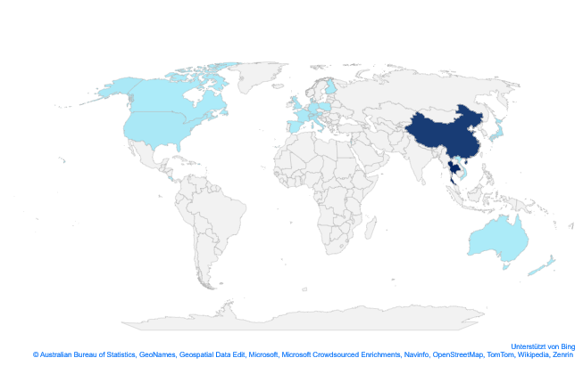
Global incidence varies with differences seen between CCA subtypes^{1,2}
Maximum reported Incidence of CCA²
CCA incidence varies globally, presumably reflecting differences in geographical risk factors and genetic determinants¹
A general increase in iCCA incidence worldwide has been reported³
This is potentially due to an improvement in the ability to accurately diagnose iCCA^{3,4}
The incidences of pCCA and dCCA seem to be decreasing²
THAILAND | 85.00
SOUTH KOREA | 8.75
CHINA | 7.55
JAPAN | 3.50
ITALY | 3.36
GERMANY | 3.00
UK | 2.70
AUSTRIA | 2.67
USA | 1.60
SINGAPORE | 1.45
FRANCE | 1.30
DENMARK | 1.27
FINELAND | 1.05
POLAND | 0.70
SPAIN | 0.50
SWITZERLAND | 0.45
AUSTRALIA | 0.43
NEW ZEALAND | 0.40
CANADA | 0.35
PUERTO RICO | 0.35
COSTA RICA | 0.30
ISRAEL | 0.30
VIETNAM | 0.10
Incidence (per 100,000 people)
• Rare cancer <6 cases • Non-rare cancer ≥ 6 cases
CCA, cholangiocarcinoma; dCCA, distal cholangiocarcinoma; iCCA, intrahepatic cholangiocarcinoma; pCCA perihilar cholangiocarcinoma
1. Khan SA, et al. Liver Int. 2019;39(Suppl. 1):19–31; 2. Banales JM, et al. Nat Rev Gastroenterol Hepatol. 2016;13(5):261–280; 3. Banales JM, et al. Nat Rev Gastroenterol Hepatol. 2020;17(9):557–588; 4. NCCN. Hepatobiliary cancers – NCCN Clinical Practice Guidelines in Oncology (NCCN Guidelines). Version 3.2021 June 17 2021

Slide 5
Mortality rates for iCCA are increasing while survival rates remain low^{1, 2}
5-year survival rates of patients from the USA with CCA²
Average change iCCA ⬆ 3.75% and eCCA ⬇ 6.45%
A reduction in eCCA mortality rates follows the increased use of laparoscoptic cholecystectomy.
CCA, cholangiocarcinoma; eCCA extrahepatic cholangiocarcinoma; iCCA, intrahepatic cholangiocarcinoma
1. Vithayathil M et al. J Hepatol. 2022; 77(6): 1690-1698; 2. Bibeau K, et al. Oral presentation at: ASCO Gastrointestinal Cancers Virtual Symposium; January 15–17, 2021

Slide 6
2. Molecular profiling

Slide 7
Importance of molecular profiling and main actionable targets
Actionable genomic alterations have been identified in over 50% of patients with iCCA^{1,2}
IDH1 and FGFR2 are currently seen as the primary actionable targets within BTC and these occur predominantly in iCCA^{1,3}
Rates of mutation vary highly between sources and can differ geographically⁴
A meta-analysis of studies identifying iCCA cancers harbouring IDH1 mutations showed^{:4}
13.1% (522 / 4214) incidence rate with included papers ranging between 4.5% to 55.6%.
16.5% (399 / 2416) incidence at treatment sites outside of Asia compared to 8.8% (86 / 981) treated at Asian sites.
A reduced incidence (1.6-1.9% vs 4.2-10.9%) in liver fluke populations may explain the differing incidence between sites.
CCA, cholangiocarcinoma; eCCA extrahepatic cholangiocarcinoma; iCCA, intrahepatic cholangiocarcinoma; IDH1, isocitrate dehydrogenase 1; FGFR2, fibroblast growth factor receptor 2
1. Lamarca A, et al. J Hepatol. 2020;73(1):170–185; 2. Verdaguer H et al. Clin Cancer Res. 2022; 28(8):1662-1671; 3. Lowery MA et al. Clin Cancer Res. 2018; 24(17): 4154-4161; 4. Boscoe AN et al. J Gastrointest Oncol. 2019; 10(4):751-765

Slide 8
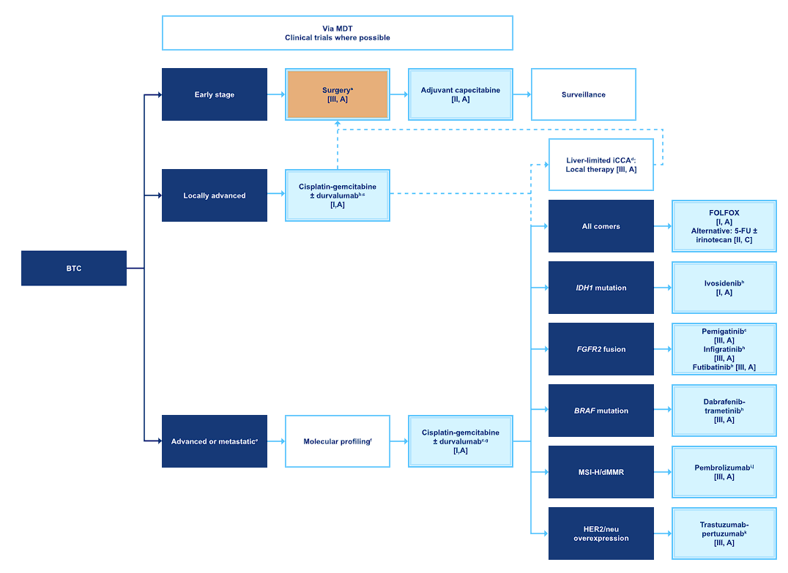
Recommendations for Molecular Profiling ESMO Guidelines for Biliary Tract Cancer (Nov 2022)¹
“Molecular profiling should be performed before/during first-line therapy.”
“Gene panel should include FGFR2, IDH1, HER2/neu and BRAF to test for hotspot mutations, but may also include genes such as NTRK and c-MET”
1. Vogel A et al. Ann Oncol. 2022; S0923-7534(22)04699-3

Slide 9
Importance of molecular profiling and main actionable targets
Molecular profiling classifies tumours based on their genetic make-up by identifying unique DNA changes, including¹
Mutation(s) in specific portions of normal gene DNA sequences
Gene amplification(s) in which the number of gene copies is increased
Gene fusion(s) in which two genes become joined together
Next Generation Sequencing (NGS) is commonly used to guide treatment decisions
DNA and RNA sequencing will pick up different changes as per the table^{2,3}
ESCAT Recommended CCA Targets (Sorted by Method of Detection)³
Detection Method | ESCAT I Targets | ESCAT II & III Targets
DNA Sequencing | IDH1 (Mutation) BRAF V600E (Mutation) HER2 / ERBB2 (Amplification) KRAS (Mutation) | IDH2 (Mutation) FGFR2 (Mutation) HER2 / ERBB (Mutation) BRCA 1/2 (Mutation) PALB2 (Mutation)
RNA Sequencing | FGFR2 (Fusion) NTRK (Fusion)
IHC | MSI-H (High) HER2 / ERBB2 (Amplification)
FISH | HER2 / ERBB2 (Amplification)
IDH1 and FGFR2 are two major actionable targets and require different detection methods (DNA Sequencing and RNA Sequencing)
CCA, cholangiocarcinoma; ESCAT, ESMO Scale for Clinical Actionability of molecular Targets; IHC, immunohistochemistry; FISH, fluorescence in situ hybridisation; BRAF, v-raf murine sarcoma viral oncogene homolog B1; BRCA, Breast Cancer gene; FGFR2, Fibroblast Growth Factor Receptor 2; HER2, Human Epidermal growth factor Receptor 2; ERBB, Erythroblastic Eukemia Viral Oncogene Homolog 2; IDH1, Isocitrate Dehydrogenase 1; IDH2, Isocitrate Dehydrogenase 2; KRAS, Kirsten Rat Sarcoma Viral Oncogene Homolog; MSI-H, Microsatellite Instability-High; NTRK, Neurotrophic Tyrosine Receptor Kinase; PALB2, Partner and Localiser of BRCA2
1. Incyte Corp. What is molecular profiling? https://www.testmycholangio.com/molecular-profiling-in-cca. Accessed November 12, 2021; 2. Freedman AN et al. JCO Precis Oncol. 2018; 21800169; 3. Vogel A et al. Ann Oncol. 2022; S0923-7534(22)04699-3

Slide 10
Summary Table of Molecular Targets (ESCAT I) Ordered by ESCAT Score
Gene | Alteration | Prevalence (BTC) | ESCAT | Example Drugs | Trial | Trial Design
IDH1 | Mutation | 1-18% | I-A | ivosidenib | ClarIDHy | Phase 3 DB RCT
FGFR2 | Fusion | < 10% | I-B | pemigatinib, infigratinib | FIGHT-202 CBGJ398X2204 | Phase 2 Single Arm Phase 2 Single Arm
BRAF V600E | Mutation | < 5% | I-B | dabrafenib+ trametinib | ROAR | Phase 2 Basket
HER2 (ERBB2) | Amplification | 5-10% | I-C | pertuzumab+ trastuzumab | MyPathway | Phase 2a Basket
MSI-H |  | < 1% | I-C | pembrolizumab | KEYNOTE-158 | Phase 2 Basket
KRAS | Mutation | < 1% | I-C | adagrasib | KRYSTAL-1 | Phase 1/2 Basket
NTRK | Fusion | < 1% | I-C | larotrectinib, entrectinib | Pooled Analysis^{2,3} | Pooled Analyses (Phase 1 & 2 Basket)
BTC, biliary tract cancer; ESCAT, ESMO Scale for Clinical Actionability of molecular Targets
BRAF, v-raf murine sarcoma viral oncogene homolog B1; FGFR2, Fibroblast Growth Factor Receptor 2; HER2, Human Epidermal growth factor Receptor 2; ERBB, Erythroblastic Eukemia Viral Oncogene Homolog 2; IDH1, Isocitrate Dehydrogenase 1; KRAS, Kirsten Rat Sarcoma Viral Oncogene Homolog; MSI-H, Microsatellite Instability-High; NTRK, Neurotrophic Tyrosine Receptor Kinase
1. Vogel A et al. Ann Oncol. 2022; S0923-7534(22)04699-3; 2. Hong DS et al. Clin Oncol. 2021;39(15_suppl):3108; 3. Doebele RC et al. Lancet Oncol. 2020; 21(2):271-282

Slide 11
Summary Table of Molecular Targets (ESCAT II & III) Ordered by ESCAT Score
Gene | Alteration | Prevalence (BTC) | ESCAT | Example Drugs | Trial | Trial Design
HER2 | Mutation | 3-5% | II-B | trastuzumab | MyPathway | Phase 2a Basket
FGFR2 | Mutation | 2% | II-B | derazantinib, erdafinib | FIDES-01 NCT02699606 | Phase 2 Single Arm Phase 2 Single Arm
IDH2 | Mutation | < 5% | III-A | enasidinib | NCT01915498 | Phase 1/2 Single Arm (Acute Myeloid Leukaemia)
BRCA1/2 | Mutation | 3-5% | III-A | olaparib | POLO | Phase 3 DB RCT (PDAC Maintenance)
PALB2 | Mutation | 1% | III-A | rucaparib | NCT03140670 | Phase 2 Single Arm (PDAC Maintenance)
BTC, biliary tract cancer; ESCAT, ESMO Scale for Clinical Actionability of molecular Targets; DB RCT, double blind randomised controlled trial; PDAC, pancreatic ductal adenocarcinoma
BRCA, Breast Cancer gene; FGFR2, Fibroblast Growth Factor Receptor 2; HER2, Human Epidermal growth factor Receptor 2; IDH2, Isocitrate Dehydrogenase 2; PALB2, Partner and Localiser of BRCA2
1. Vogel A et al. Ann Oncol. 2022; S0923-7534(22)04699-3

Slide 12
3. Rationale for mIDH inhibitors

Slide 13
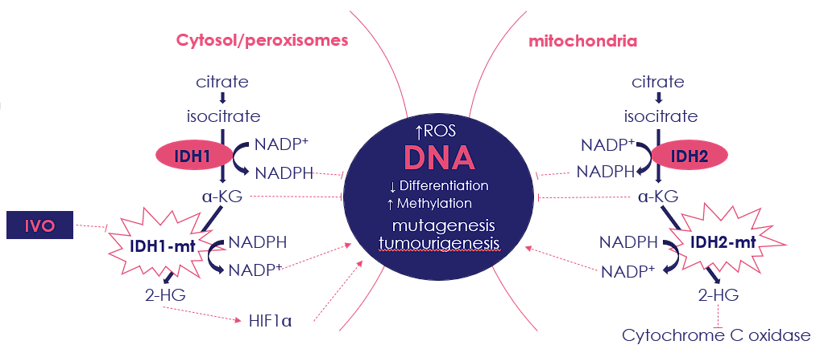
IDH mutations are gain-of-function leading to an increase in 2HG^{1,2}
IDH1/2 subtypes are the most relevant for catalyzing the NADP⁺-dependent oxidative decarboxylation of isocitrate to αKG and CO₂
IDH mutations
Are considered gain-of-function
Occur early in oncogenesis²
Lead to the disruption of the normal catalytic activity of IDH1/2
Result in increased conversion of αKG to 2HG oncometabolite, which promotes tumour proliferation and metastasis development
2HG, R(-)-2-hydroxyglutarate; αKG, α-ketoglutarate; CO₂, carbon dioxide; CoA, coenzyme A; IDH, isocitrate dehydrogenase; mut, mutant; NADP, nicotinamide adenine dinucleotide phosphate; NADPH, nicotinamide adenine dinucleotide phosphate (reduced); HIF1α: hypoxia-inducible factor-1 subunit α; TET, ten-eleven translocation; wt, wild-type
1. Salati M, et al. Cancers (Basel). 2020;12(11):3310; 2. Golub D et al. Front Oncol. 2019; 9417;

Slide 14
IDH inhibitors restore normal cell differentiation by targeting mIDH and blocking production of 2HG^{1–3}
Cell differentiation is a therapeutic target for mIDH inhibitors^{1–3}
Selective targeting of mIDH enzyme blocks production of 2HG, which may restore appropriate methylation state and promote normal cell differentiation^{1–3}
2HG
2HG
Blocked Demethylation
2HG
Blocked Differentiation
2HG
DNA & Histone Demethylase
mIDH
2HG
x
x
x
x
x
αHG
mIDH
αHG
αHG
DNA & Histone Demethylase
mIDH
Inhibitor
Active Demethylation
Release of Blocked
Differentiation
2HG, R(-)-2-hydroxyglutarate; αKG, α-ketoglutarate; IDH, isocitrate dehydrogenase; Me, methyl group; mIDH, mutant isocitrate dehydrogenase
1. Kernytsky A, et al. Blood. 2015;125(2):296–303; 2. Rohle D, et al. Science. 2013;340(6132):626–630; 3. Wang F, et al. Science. 2013;340(6132):622–626

Slide 15
4. ClarIDHy study

Slide 16
Phase III ClarIDHy study: Design and endpoints¹
Key eligibility criteria
≥18 years of age
Histologically confirmed diagnosis of CCA
Centrally confirmed mIDH1* status by NGS
ECOG PS score 0 or 1
1−2 prior therapies (at least one gemcitabine- or 5-fluorouracil-containing regimen)
Measurable lesion as defined by RECIST v1.1
Adequate hematologic, hepatic, and renal function
Pre-screening for IDH1 mutation
2:1 double-blind randomisation (n=187)
Ivosidenib 500 mg QD orally in continuous 28-day (±2 days) cycles (n=126)
Crossover permitted at radiographic disease progression
Stratified by number of prior therapies
Placebo (n=61)
An independent Data Monitoring Committee monitored the safety data throughout the study
NCT02989857
Adapted from The Lancet Oncology, 21, Abou-Alfa et al, Ivosidenib in IDH1-mutant, chemotherapy-refractory cholangiocarcinoma (ClarIDHy): a multicentre, randomised, double-blind, placebo-controlled, phase 3 study, 796–807, Copyright 2021, with permission from Elsevier.
Primary endpoint: PFS by blinded IRC
Key secondary endpoints: OS; ORR
Other secondary endpoints: PFS by investigator; pharmacokinetics/pharmacodynamics; HRQoL assessed using EORTC QLQ-C30, EORTC QLQ-BIL21, PGI questions, and EQ-5D-5L; safety and tolerability
*IDH1 mutation status prospectively confirmed by NGS-based Oncomine™ Focus Assay on formalin-fixed, paraffin-embedded tumour tissue in a Clinical Laboratory Improvement Amendments-certified laboratory
CCA, cholangiocarcinoma; ECOG PS, Eastern Cooperative Oncology Group performance status; EORTC, European Organisation for Research and Treatment of Cancer; EQ-5D-5L, 5-level EuroQoL-5 Dimension questionnaire; HRQoL, health-related quality of life; IDH, isocitrate dehydrogenase; IRC, independent radiology center; mIDH, mutant isocitrate dehydrogenase; NGS, next-generation sequencing; ORR, objective response rate; OS, overall survival; PFS, progression-free survival; PGI, Patient Global Impression; QD, once daily; QLQ-BIL21, Cholangiocarcinoma and Gallbladder Cancer module; QLQ-C30, Quality of Life Questionnaire Core 30; RECIST, Response Evaluation Criteria in Solid Tumours
1. Abou-Alfa GK, et al. Lancet Oncol. 2020;21:796–807

Slide 17
Baseline characteristics and patient disposition¹
Characteristic | Ivosidenib n=126 | Placebo n=61
Randomisation strata, n (%) One prior line of therapy Two prior lines of therapy | 66 (52.4) 60 (47.6) | 33 (54.1) 28 (45.9)
ECOG PS score at baseline,* n (%) 0 1 | 50 (39.7) 75 (59.5) | 19 (31.1) 41 (67.2)
CCA type at diagnosis, n (%) Intrahepatic Extrahepatic/perihilar Unknown | 113 (89.7) 5 (4.0) 8 (6.3) | 58 (95.1) 1 (1.6) 2 (3.3)
Extent of disease at screening, n (%) Local/regional Metastatic | 9 (7.1) 117 (92.9) | 5 (8.2) 56 (91.8)
 | Ivosidenib n=126 | Placebo n=61**
Treated, n (%) | 123 (97.6) | 59 (96.7)
On treatment | 8 (6.5) | 0
Discontinued treatment | 115 (93.5) | 59 (100)
Progressive disease | 92 (74.8) | 51 (86.4)
Adverse events | 8 (6.5) | 4 (6.8)
Withdrawal by patient | 6 (4.9) | 2 (3.4)
Death | 5 (4.1) | 0
Withdrawal of consent | 2 (1.6) | 1 (1.7)
Other | 2 (1.6) | 1 (1.7)
Not treated, n (%) | 3 (2.4) | 2 (3.3)
On study, n (%) | 24 (19.0) | 9 (14.8)
*Two patients had an ECOG PS worsen to 2 (placebo) and 3 (ivosidenib) at baseline assessment upon study start
**As of May 31, 2020, 43 of 61 patients in the placebo group crossed over to receive ivosidenib upon radiographic disease progression. ‘Death’ or ‘withdrawal of consent’ was captured as the end of study reason in 14 of the remaining 18 patients who did not crossover (death, n=12; withdrawal of consent, n=2)
CCA, cholangiocarcinoma; ECOG PS, Eastern Cooperative Oncology Group performance status
1. Zhu AX, et al. JAMA Oncol. 2021;7(11):1669–1677

Slide 18
Treatment duration¹
All patients treated with ivosidenib (n=123)
All patients treated with placebo (light blue, n=59), including those who crossed over to ivosidenib (blue, n=43)
Ongoing
Ongoing
Median treatment duration on placebo: 1.6 (0–6.9) months
Median treatment duration on ivosidenib after crossover: 2.7 (0.3–29.8) months
Median treatment duration on ivosidenib: 2.8 (0.1–34.4) months
70.5% (43/61) of patients receiving placebo crossed over to open-label ivosidenib upon radiographic disease progression and unblinding as permitted by the study protocol
25 (15.1%) patients, including six patients who crossed over from placebo, remained on ivosidenib for ≥1 year
1. Zhu AX, et al. JAMA Oncol. 2021;7(11):1669–1677

Slide 19
Primary endpoint of PFS by IRC¹
+
Censored
 | Ivosidenib | Placebo
PFS
Median (months) | 2.7 | 1.4
6-month rate (%) | 32 | NE
12-month rate (%) | 22 | NE
Disease control rate (%) (PR+SD) | 53 (2 PR, 51 SD) | 28 (0 PR, 28 SD)
Ivosidenib
Placebo
HR=0.37 (95% CI 0.25–0.54) one-sided p<0.0001
PFS probability
Number of patients at risk:
Ivosidenib
124
105
54
40
36
28
22
16
14
10
9
6
5
4
3
3
2
1
1
Placebo
61
46
11
6
4
1
Adapted from The Lancet Oncology, 21, Abou-Alfa et al, Ivosidenib in IDH1-mutant, chemotherapy-refractory cholangiocarcinoma (ClarIDHy): a multicentre, randomised, double-blind, placebo-controlled, phase 3 study, 796–807, Copyright 2021, with permission from Elsevier
All randomised patients as of January 31, 2019
CI, confidence interval; HR, hazard ratio; IRC, independent radiology center; NE, not estimable; PFS, progression-free survival; PR, partial response; SD, stable disease
1. Abou-Alfa GK, et al. Lancet Oncol. 2020;21:796−807

Slide 20
PFS by IRC: ivosidenib efficacy across subgroups*¹
 | Events/N | HR | Lower 95% CI | Upper 95% CI | Hazard ratio (HR)
Overall | 126/185 | 0.37 | 0.252 | 0.543
Prior lines of therapy
1 | 66/106 | 0.37 | 0.219 | 0.612
≥ 2 | 60/79 | 0.41 | 0.234 | 0.730
Sex
Female | 74/117 | 0.36 | 0.220 | 0.589
Male | 52/68 | 0.45 | 0.249 | 0.811
Extent of disease at screening
Locally advanced | 7/14 | 0.20 | 0.035 | 1.111
Metastatic | 119/171 | 0.41 | 0.277 | 0.601
Cancer type at initial diagnosis
Intrahepatic CCA | 114/169 | 0.38 | 0.257 | 0.567
Extrahepatic CCA | 3/6
Unknown | 9/10
ECOG PS score at baseline
0 | 41/68 | 0.26 | 0.124 | 0.540
≥ 1 | 85/117 | 0.52 | 0.332 | 0.803
Regions
North America | 83/124 | 0.40 | 0.249 | 0.631
Europe | 34/49 | 0.39 | 0.188 | 0.830
Asia | 9/12 | 0.42 | 0.110 | 1.597
0
1
2
Favours ivosidenib
Favours placebo
Adapted from The Lancet Oncology, 21, Abou-Alfa et al, Ivosidenib in IDH1-mutant, chemotherapy-refractory cholangiocarcinoma (ClarIDHy): a multicentre, randomised, double-blind, placebo-controlled, phase 3 study, 796–807, Copyright 2021, with permission from Elsevier
*Subgroups with number of events ≤5 or number of patients ≤10 were not plotted. All randomised patients as of January 31, 2019
CI, confidence interval; ECOG PS, Eastern Cooperative Oncology Group Performance Status; HR, hazard ratio; IRC, independent radiology center; PFS, progression-free survival
1. Abou-Alfa GK, et al. Lancet Oncol. 2020;21:796−807

Slide 21
Pre-specified adjustment for crossover (or treatment switch)
A crossover (or treatment switch) was included in the trial design for ethical reasons.
Upon radiographic disease progression, patients in the placebo group were allowed to receive open-label ivosidenib,¹ however this confounds the treatment effect estimate on OS.
Rank-preserving structural failure time model (RPSFT) is an established statistical method to adjust for the effect of treatment switching²⁻⁴
REACHIN and ABC-06 were trials in 2L advanced BTC without crossover. Both included biliary-tract cancers non-selective for IDH1-mutation:
Trial Name | Trial Type | Population | Median OS (m
 |  |  | Placebo | Active
Demols et al, 2020 | REACHIN trial Phase 2 placebo vs regorafenib in advanced BTC | N=66 (42 IHCC) | 5.1 | 5.3
Lamarca et al, 2019 | ABC-06 Phase 3 randomised, open label in second-line advanced BTC ASC vs mFOLFOX | N=162 (117 CCA, 72 IHCC) | 5.3 | 6.2
BTC, biliary tract cancer; OS, overall survival; RPSFT, rank-preserving structural failure time; RPSFTM, rank-preserving structural failure time model
1. Abou-Alfa GK, et al. Lancet Oncol. 2020;21:796−807; 2. Robins JM, Tsiatis AA. Commun Stat Theory Methods, 1991;20:2609−2631; 3. Watkins C, et al. Pharm Stat. 2013;12:348–357; 4. Morden JP, et al. BMC Med Res Methodol. 2011;11:4; 5. Boscoe AN et al. J Gastrointest Oncol. 2019; 10(4):751-765

Slide 22
Overall Survival (OS): final analysis¹
 | Ivosidenib n=126 | Placebo n=61 | Placebo (RPSFT adjusted) n=61
Number of events (%) | 100 (79.4) | 50 (82.0) | 49 (80.3)
Median OS (months) | 10.3 | 7.5 | 5.1
HR (95% CI) | 0.79 (0.56–1.12) |  | 0.49 (0.34–0.70)
One-sided p value | 0.093 |  | <0.001
6-month OS rate (%) | 69 | 57
12-month OS rate (%) | 43 | 36
+
Censored*
Ivosidenib
Placebo
Placebo (RPSFT adjusted)
OS probability
Number of patients at risk:
Survival (months)
Ivosidenib
126
113
97
85
72
62
53
48
42
32
25
18
14
10
7
6
5
2
Placebo
61
50
43
35
29
27
21
18
17
12
8
4
4
2
1
1
1
Placebo
(RPSFT adj.)
61
49
37
29
21
14
6
4
2
1
1
All randomised patients as of May 31, 2020
*Patients without documentation of death at the data cutoff date were censored at the date the patient was last known to be alive or the data cutoff date, whichever was earlier
Adj., adjusted; CI, confidence interval; HR, hazard ratio; OS, overall survival; RPSFT, rank-preserving structural failure time
1. Zhu AX, et al. JAMA Oncol. 2021;7(11):1669–1677

Slide 23
HRQoL results: change from baseline at cycle 2, day 1¹
EORTC QLQ-C30 global heath status/QoL and functional subscales*
EORTC QLQ-C30 symptom subscales†
EORTC QLQ-BIL21 symptom subscales†
p value
p value
p value
Global health status/QoL | 0.116
Physical functioning | 0.002
Social functioning | 0.052
Role functioning | 0.657
Cognitive functioning | 0.029
Emotional functioning | < 0.001
Fatigue | 0.160
Nausea and vomiting | 0.924
Pain | 0.039
Dyspnea | 0.026
Insomnia | 0.839
Appetite loss | 0.488
Constipation | 0.857
Diarrhea | 0.359
Financial difficulties | 0.137
Weight loss | 0.520
Drains | 0.358
Treatment side effects | 0.707
Anxiety | 0.009
Pain | 0.206
Tiredness | 0.006
Jaundice | 0.440
Eating | 0.858
40
20
0
-20
LS mean difference (95% CI)
LS mean difference (95% CI)
LS mean difference (95% CI)
Favors ivosidenib
Favors placebo
Favors ivosidenib
Favors placebo
Favors ivosidenib
Favors placebo
At cycle 2, day 1: n=21 for placebo and n=67 for ivosidenib (QLQ-C30); n=20 for placebo and n=65 for ivosidenib (QLQ-BIL21). All randomised patients as of May 31, 2020
Bold text indicates p<0.05 and orange boxes highlight prespecified subscales; *Higher scores denote better health status or function; †Higher scores denote worse symptoms
CI, confidence interval; EORTC, European Organisation for Research and Treatment of Cancer; HRQoL, health-related quality of life; LS, least squares; QLQ-BIL21, Cholangiocarcinoma and Gallbladder Cancer module; QLQ-C30, Quality of Life Questionnaire Core 30; QoL, quality of life
1. Zhu AX, et al. JAMA Oncol. 2021;7(11):1669–1677

Slide 24
Treatment Emergent Adverse Events (TEAEs)¹ Grade ≥3
 | Placebo n=59 | Ivosidenib n=123 | Total ivosidenib n=166*
Grade ≥3 TEAE n (%)
Most common Grade ≥3 TEAEs (≥3%†), n (%)
Ascites | 4 (6.8) | 11 (8.9) | 15 (9.0)
Anemia | - | 8 (6.5) | 12 (7.2)
Blood bilirubin increased | 1 (1.7) | 7 (5.7) | 9 (5.4)
Aspartate aminotransferase increased | 1 (1.7) | 6 (4.9) | 8 (4.8)
Hyponatremia | 1 (1.7) | 7 (5.7) | 8 (4.8)
Hypophosphatemia | 3 (5.1) | 4 (3.3) | 6 (3.6)
Fatigue | 1 (1.7) | 4 (3.3) | 5 (3.0)
Hypertension | 1 (1.7) | 2 (1.6) | 5 (3.0)
Hyperbilirubinemia | 0 (0) | 4 (3.3) | 4 (2.4)
Most common grade ≥3 TEAEs‡
Ascites (6.8% vs 9.0%)
Anemia (0% vs 7.2%)
Blood bilirubin increased (1.7% vs 5.4%)
Grade 4 TEAEs were limited to:
Hyponatremia (0% vs 1.2%)
Hyperbilirubinemia (0% vs 1.2%)
Blood bilirubin increased (0% vs 0.6%)
No Grade 5 TEAEs were reported.
*Total ivosidenib includes 43 patients initially assigned to placebo who had crossed over to ivosidenib upon radiographic disease progression and unblinding. All randomised patients as of May 31, 2020; †≥3% cutoff used for Grade ≥ 3 TEAEs based on total ivosidenib; ‡≥ 3% cutoff used for grade ≥3 TEAEs based on total ivosidenib
TEAE, treatment-emergent adverse event
1. Zhu AX, et al. JAMA Oncol. 2021;7(11):1669–1677

Slide 25
Treatment Emergent Adverse Events (TEAEs)¹ Any Grade
 | Placebo n=59 | Ivosidenib n=123 | Total ivosidenib n=166*
Any Grade TEAE, n (%) | 57 (96.6) | 120 (97.6) | 161 (97.0)
Most common TEAEs (>15%†), n (%)
Nausea | 17 (28.8) | 51 (41.5) | 63 (38.0)
Diarrhea | 10 (16.9) | 43 (35.0) | 55 (33.1)
Fatigue | 10 (16.9) | 38 (30.9) | 48 (28.9)
Abdominal pain | 9 (15.3) | 30 (24.4) | 37 (22.3)
Cough | 5 (8.5) | 31 (25.2) | 36 (21.7)
Decreased appetite | 11 (18.6) | 30 (24.4) | 36 (21.7)
Ascites | 9 (15.3) | 28 (22.8) | 33 (19.9)
Vomiting | 11 (18.6) | 28 (22.8) | 33 (19.9)
Anemia | 3 (5.1) | 22 (17.9) | 30 (18.1)
Edema peripheral | 6 (10.2) | 17 (13.8) | 25 (15.1)
For placebo vs total ivosidenib:
Most common TEAEs are GI based
TEAEs leading to discontinuation were more common for placebo (8.5% vs 6.6%) than total ivosidenib
TEAEs leading to dose reductions (0% vs 3.0%) and interruptions (18.6% vs 30.1%) were less common for placebo relative to total ivosidenib
*Total ivosidenib includes 43 patients initially assigned to placebo who had crossed over to ivosidenib upon radiographic disease progression and unblinding. All randomised patients as of May 31, 2020; †>15% cutoff used for all-grade TEAEs based on total ivosidenib; ‡>5% cutoff used for grade ≥3 TEAEs based on total ivosidenib
TEAE, treatment-emergent adverse event
1. Zhu AX, et al. JAMA Oncol. 2021;7(11):1669–1677

Slide 26
Recommendations for managing Adverse Events
QTc Interval Prolongation:
Ivosidenib causes prolongation of the QTc interval, and ventricular arrhythmias have been reported following treatment with ivosidenib
In the ClarIDHy trial QTc prolongation was reported in 10% with 2% of patients experiencing Grade 3 or QTc prolongation.
Based on the analysis of the ECGs, 2% of patients had a QTc interval ˃ 500 msec and 5% had QTc interval prolongation ˃60 msec from baseline.
No patient discontinued treatment due to QTc prolongation, and dose reduction to manage signs/symptoms was required in 3% of patients.
The median time to onset after treatment initiation was 28 days (range: 1 day to 698 days [23 months].
Monitoring Recommendations:
Perform an ECG at baseline, at least weekly during the first 3 weeks of therapy and at least monthly thereafter.
Patients at higher risk of QT prolongation, including due to concomitant medications, may require more frequent monitoring.
If QTc increases to greater than 480ms and less than 500ms:
Review concomitant medicines and check electrolytes.
Interrupt ivosidenib treatment until QTc interval returns to ≤480 msec, then resume at 500 mg daily.
Monitor ECGs at least weekly for 2 weeks following return of QTc interval to ≤480msec.
If QTc increases to greater than 500ms:
Review concomitant medicines and check electrolytes.
Interrupt ivosidenib treatment until QTc interval returns to within 30 msec of baseline or ≤480 msec, then resume treatment at 250 mg daily.
Monitor ECGs at least weekly for 2 weeks following return of QTc interval to within 30 msec of baseline or ≤480 msec.
Dose re-escalation to 500 mg daily can be considered if alternative aetiology for QTc interval prolongation is identified.
If QTc interval prolongation with signs/symptoms of life-threatening ventricular arrhythmia:
Permanently discontinue ivosidenib.
Australian Product Information – TIBSOVO® (ivosidenib) (Updated 5 April 2023) available at https://servier.wpenginepowered.com/wp-content/uploads/2023/04/TIBSOVO_PI_v1_05-04-2023.pdf accessed 30 June 2023

Slide 27
Recommendations for managing Adverse Events
Guillain-Barré Syndrome:
Two cases of Guillain-Barré syndrome (<1%) occurred in patients with haematological malignancies receiving ivosidenib. A causal mechanism is not known, and preclinical studies did not identify the CNS as a target organ for ivosidenib toxicity.
No cases of Guillain-Barré syndrome have been reported in patients with solid tumours, though peripheral neuropathy is common.
Recommendations:
Monitor patients taking ivosidenib for onset of new signs or symptoms of motor and/or sensory neuropathy such as unilateral or bilateral weakness, sensory alterations, paresthesias, or difficulty breathing.
Permanently discontinue ivosidenib in patients who are diagnosed with Guillain Barré syndrome.
Other Grade 3 or higher adverse reactions:
Interrupt ivosidenib until toxicity resolves to Grade 1 or lower, or baseline, then resume at:
500 mg daily (Grade 3 toxicity); or
250 mg daily (Grade 4 toxicity).
If Grade 3 toxicity recurs (a second time), reduce ivosidenib dose to 250 mg daily until the toxicity resolves, then resume 500 mg daily.
If Grade 3 toxicity recurs (a third time), or Grade 4 toxicity recurs, discontinue ivosidenib.
Australian Product Information – TIBSOVO® (ivosidenib) (Updated 5 April 2023) available at https://servier.wpenginepowered.com/wp-content/uploads/2023/04/TIBSOVO_PI_v1_05-04-2023.pdf accessed 30 June 2023

Slide 28
Conclusions
ClarIDHy is the first randomised, phase III study of a targeted, oral therapeutic with a non-cytotoxic mechanism of action in patients with advanced mIDH1 CCA^{1–3}
Ivosidenib treatment
Demonstrated a highly statistically significant improvement in PFS (HR=0.37, one-sided, p<0.0001) compared with placebo³
Resulted in a numeric improvement in median OS despite a high rate of crossover from the placebo arm (~70%), and this improvement was further supported by the RPSFT adjustment for crossover (HR=0.49, one-sided, p<0.001)⁴
The efficacy data, coupled with a tolerable safety profile and supportive HRQoL data demonstrate the clinical benefit of ivosidenib in this aggressive disease^{3,5}
CCA, cholangiocarcinoma; FDA, US Food and Drug Administration; HR, hazard ratio; HRQoL, health-related quality of life; mIDH, mutant isocitrate dehydrogenase; OS, overall survival; PFS, progression-free survival; RPSFT, rank-preserving structural failure time
1. Agios Pharmaceuticals Inc. Press Release. https://investor.agios.com/news-releases/news-release-details/agios-submits-supplemental-new-drug-application-fda-tibsovor. Accessed November 16, 2021; 2. Agios Pharmaceuticals Inc. https://www.servier.us/node/411. Accessed November 16, 2021; 3. Abou-Alfa GK, et al. Lancet Oncol. 2020;21:796–807; 4. Zhu AX, et al. JAMA Oncol. 2021;7(11):1669–1677; 5. Zhu AX, et al. J Clin Oncol. 2021;39(Suppl. 3):266

Slide 29
6. Regulatory history, inclusion in guidelines, and future timelines

Slide 30
International guideline inclusion^{2,3} and approval status
Granted | FDA APPROVAL FOR PATIENTS WITH IDH1-POSITIVE CCA¹ | 25 August 2021
Category 2A | NCCN GUIDELINES: BILIARY TRACT CANCERS (VER 4.2022)² | Updated October 2022
[I, A] | ESMO GUIDELINES: BILARY TRACT CANCERS³ [LoE: I, GoR: A; ESMO-MCBS v1.1 score: 3; ESCAT score: I-A] | Updated November 2022
Granted | PRIORITY & ORPHAN DESIGNATION (TGA) | May 2022
Category 1 (Upgraded) | NCCN GUIDELINES: BILIARY TRACT CANCERS (VER 1.2023)⁴ | Updated February 2023
Granted | TGA APPROVED | April 2023
Granted | EMA APPROVED | May 2023
Ongoing | ProvIDHe Phase 3b Trial (VIC, SA, NSW, QLD, WA) | June 2023 (ONGOING)
Anticipated | PBS REIMBURSEMENT (ESTIMATED) | Q4 2024 (ESTIMATE)
CCA, cholangiocarcinoma; ESMO, European Society for Medical Oncology; FDA, US Food and Drug Administration; IDH, isocitrate dehydrogenase; NCCN, National Comprehensive Cancer Network; OS, overall survival
1. FDA. FDA approves Ivosidenib for advanced or metastatic cholangiocarcinoma. https://www.fda.gov/drugs/resources-information-approved-drugs/fda-approves-ivosidenib-advanced-or-metastatic-cholangiocarcinoma. Accessed November 19, 2021; 2. NCCN. Hepatobiliary cancers – NCCN Clinical Practice Guidelines in Oncology (NCCN Guidelines). Version 4.2022, December 9, 2022; 3. Vogel A et al. Ann Oncol. 2022; S0923-7534(22)04699-3 4. NCCN. Hepatobiliary cancers – NCCN Clinical Practice Guidelines in Oncology (NCCN Guidelines). Version 1.2023, February 17 2023

Slide 31
Ivosidenib within ESMO Guidelines (Nov 2022)
Ivosidenib is recommended for the treatment of patients with CCA and IDH1 mutations who have progressed after ≥1 prior line of systemic therapy
ESMO: I, A ESMO-MCBS v1.1 score: 3 ESCAT score: I-A FDA & EMA approved
Source: Vogel A et al. Ann Oncol. 2022; S0923-7534(22)04699-3

Slide 32
Ivosidenib within NCCN Guidelines (May 2023)
NCCN Recommended Regimens for Unresectable and Metastatic Disease (Cholangiocarcinoma)
“Ivosidenib has been approved by the FDA for previously treated, locally advanced or metastatic CCA harbouring IDH1 mutations.
Ivosidenib is a category 1 useful in certain circumstances subsequent-line systemic therapy option for unresectable or metastatic progressive CCA with IDH1 mutations.”
“Testing for IDH1 mutations is recommended for patients with unresectable or metastatic intrahepatic CCA or extrahepatic CCA and should be considered for patients with unresectable or metastatic gallbladder cancer.”
 | Category 1 | Category 2A | Category 2B
Primary Treatment | Durvalumab + gemcitabine + cisplatin Gemcitabine + cisplatin | FOLFOX Capecitabine + oxaliplatin Gemcitabine + albumin-bound paclitaxel Gemcitabine + capecitabine Gemcitabine + oxaliplatin Single agents (5-fluorouracil, capecitabine, or gemcitabine) Entrectinib (if NTRK fusion) Larotrectinib (if NTRK fusion) Pembrolizumab (if MSI-H/dMMR) | Gemcitabine + cisplatin + albumin-bound paclitaxel Nivolumab + ipilimumab (if TMB-H) Pralsetinib (if RET fusion) Selpercatinib (if RET fusion)
Subsequent Therapy | Ivosidenib (if IDH1) | FOLFOX Entrectinib (if NTRK fusion) Larotrectinib (if NTRK fusion) Pembrolizumab (if MSI-H/dMMR) Pembrolizumab (if TMB-H) Nivolumab + ipilimumab (if TMB-H) Dabrafenib + trametinib (if BRAF-V600E) Futibatinib (if FGFR2 fusion) Pemigatinib (if FGFR2 fusion) Trastuzumab + pertuzumab (if HER2) Selpercatinib (if RET fusion) | FOLFIRI Regorafenib Liposomal irinotecan + fluorouracil + leucovorin Nivolumab Lenvatinib + pembrolizumab Dostarlimab-gxly (if MSI-H/dMMR) Pralsetinib (if RET fusion)
Source: NCCN. Hepatobiliary cancers – NCCN Clinical Practice Guidelines in Oncology (NCCN Guidelines). Version 2.2023, May 10 2023

